Slide 1
CORONA VIRUS DATA Analysis
Project by:
Vivek Kumar Verma

Slide 2
AIM OF THE PROJECT
As a Data Analyst, Analyze the corona virus Dataset using SQL and apply data analysis skills in a real-world context.

Slide 3
CONTENTS
Project overview
Description of Data set
Data Exploration & Analysis

Slide 4
PROJECT OVERVIEW
The CORONA VIRUS pandemic has had a significant impact on public health and has created an urgent need for data-driven insights to understand the spread of the virus.
As a data analyst, I analyzed the CORONA VIRUS dataset to derive meaningful insights and present my findings.

Slide 5
Description of each column in Data set
Province: Geographic subdivision within a country/region.
Country/Region: Geographic entity where data is recorded.
Latitude: North-south position on Earth's surface.
Longitude: East-west position on Earth's surface.
Date: Recorded date of CORONA VIRUS data.
Confirmed: Number of diagnosed CORONA VIRUS cases.
Deaths: Number of CORONA VIRUS related deaths.
Recovered: Number of recovered CORONA VIRUS cases.

Slide 6
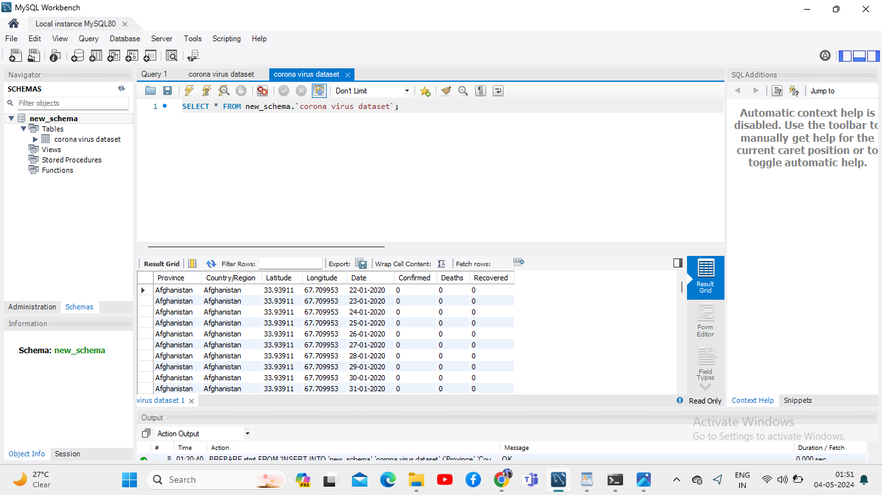
Data Set Description

Slide 7
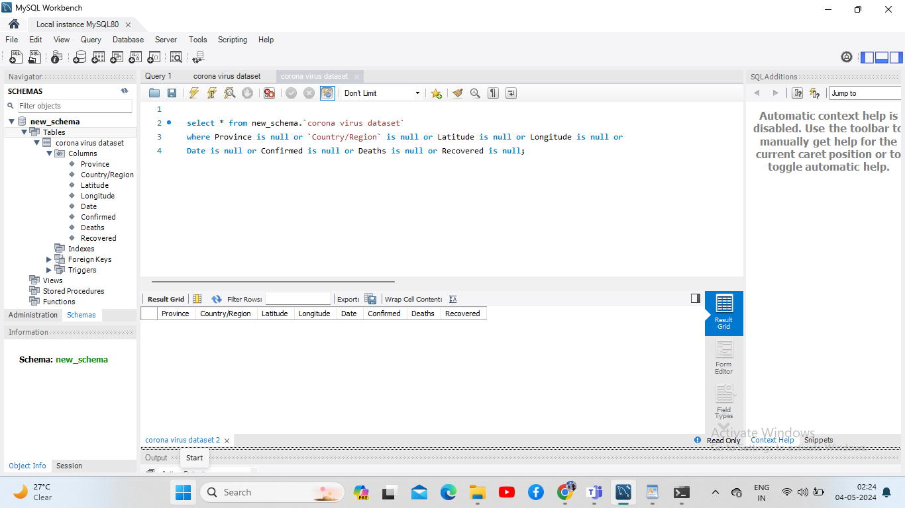
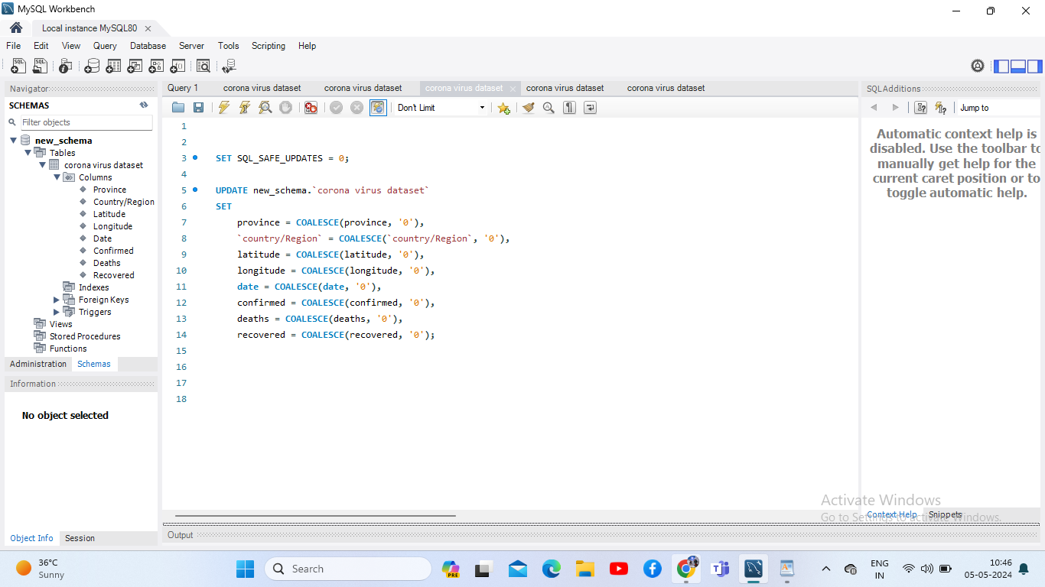
Data Exploration & Analysis
Checking for Null value Updating Null Value

Slide 8
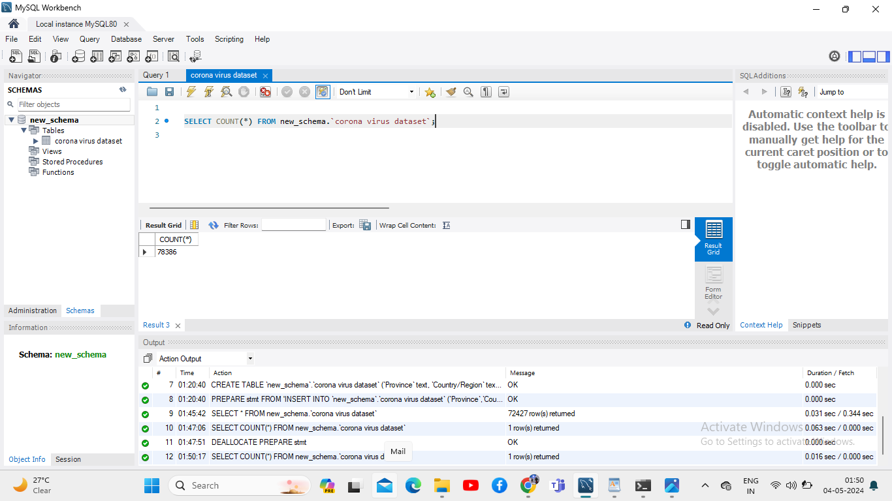
total number of rows

Slide 9
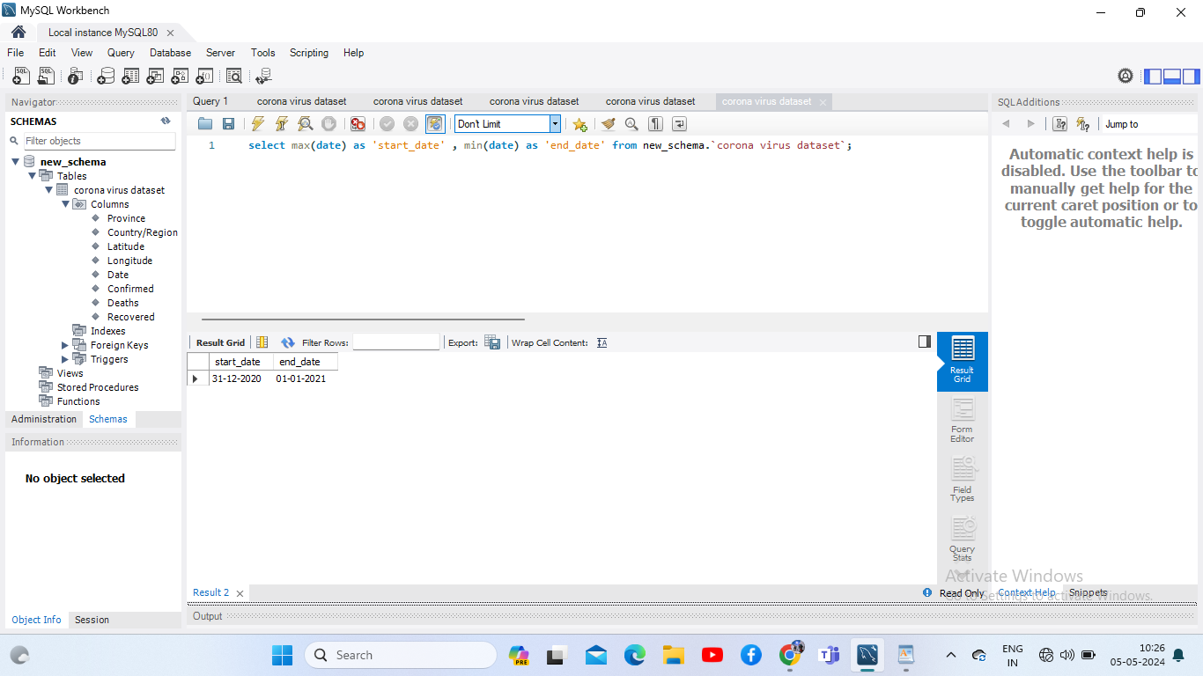
Start date and End date

Slide 10
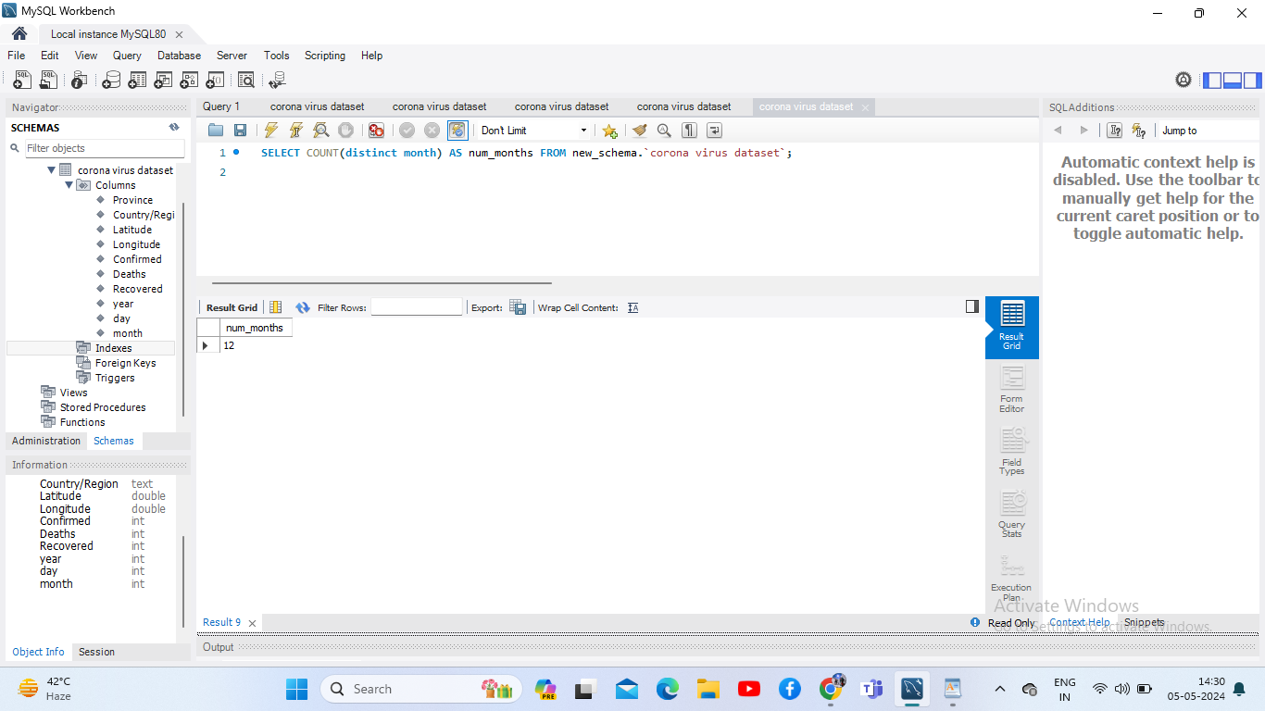
Number of month present in our dataset

Slide 11
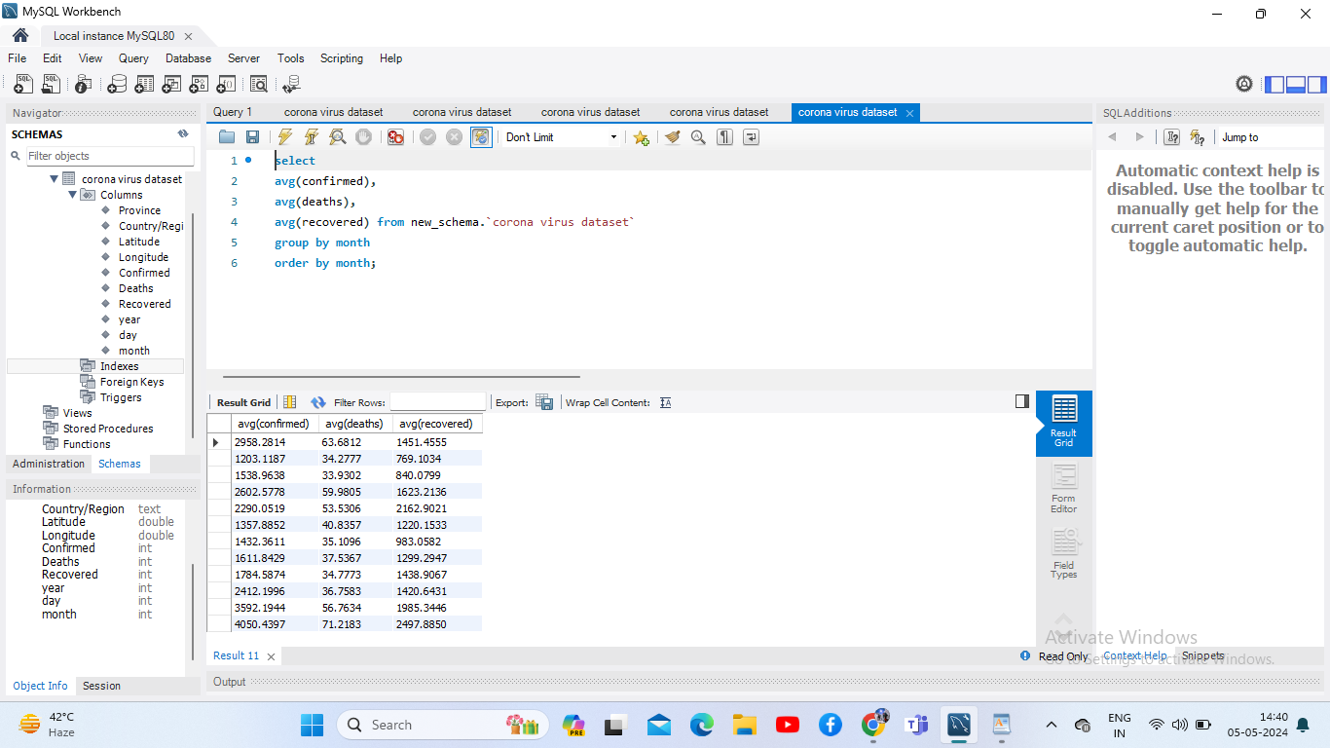
monthly average for confirmed, deaths, recovered

Slide 12
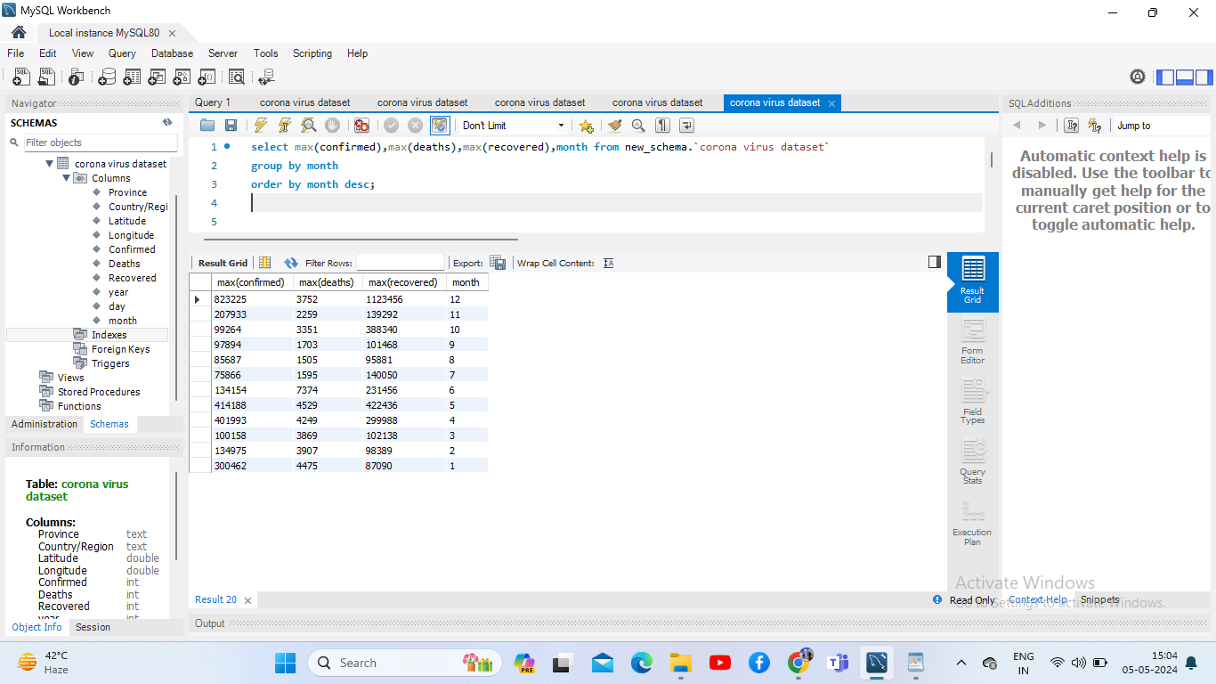
most frequent value for confirmed, deaths, recovered each month

Slide 13
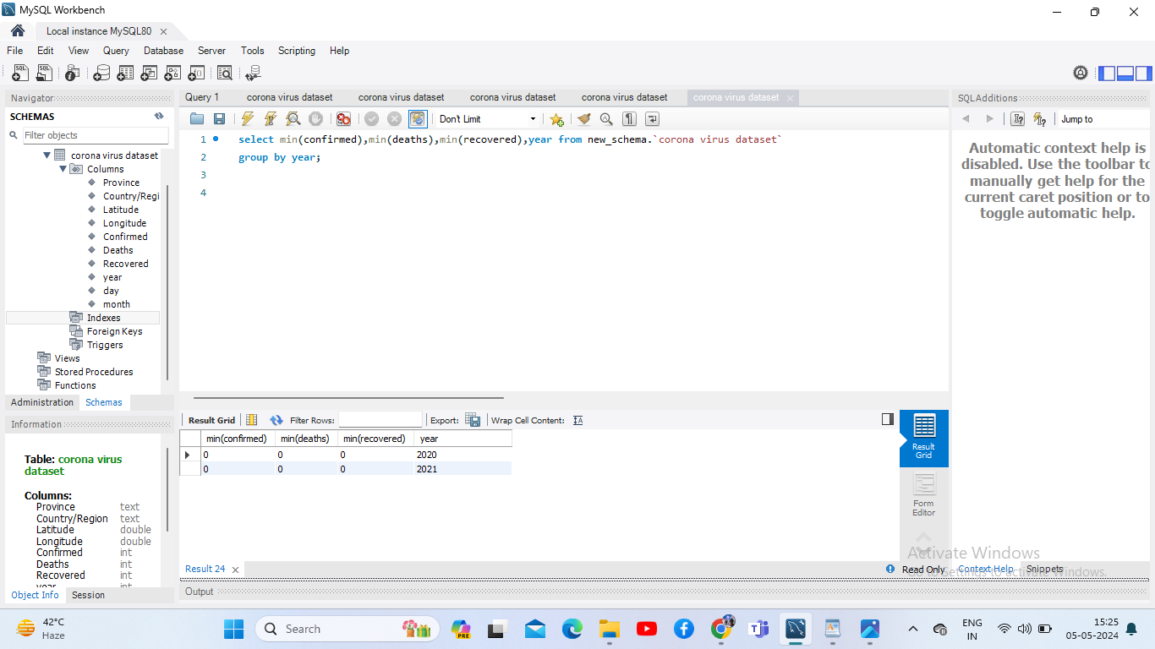
minimum values for confirmed, deaths, recovered per year

Slide 14
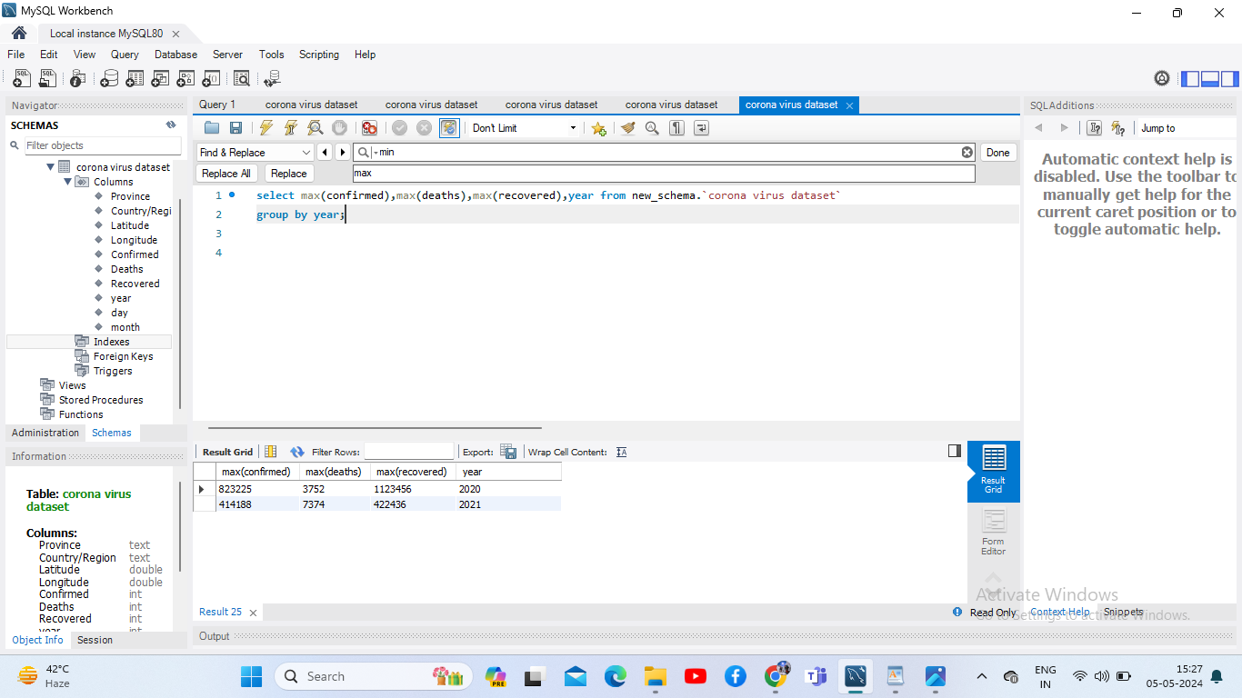
maximum values of confirmed, deaths, recovered per year

Slide 15
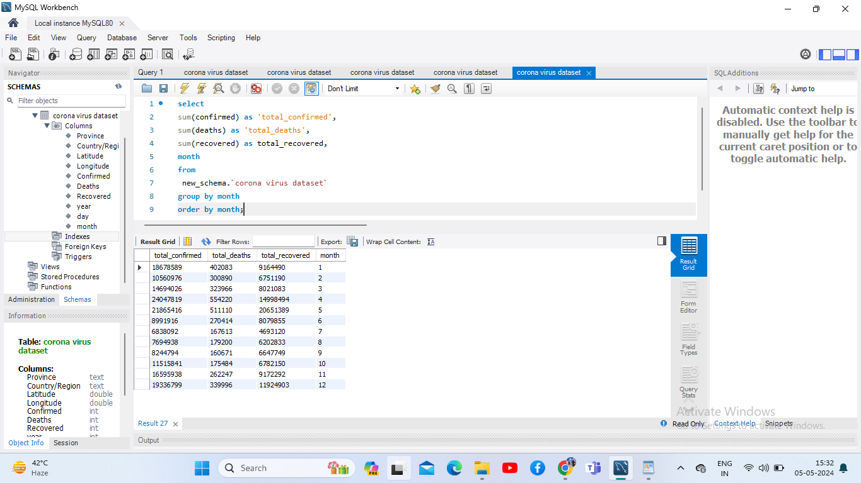
total number of case of confirmed, deaths, recovered each month

Slide 16
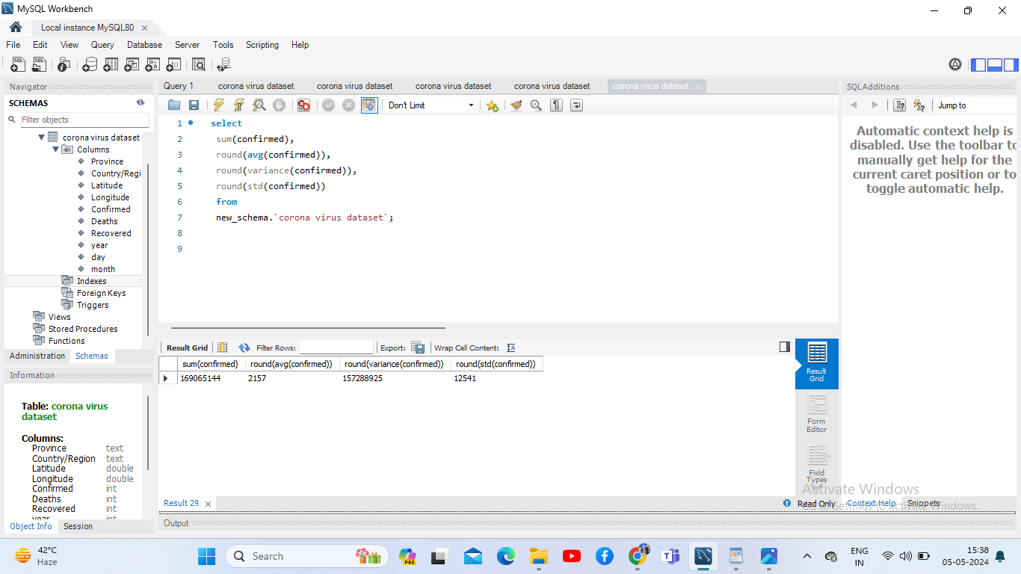
how corona virus spread out with respect to confirmed case

Slide 17
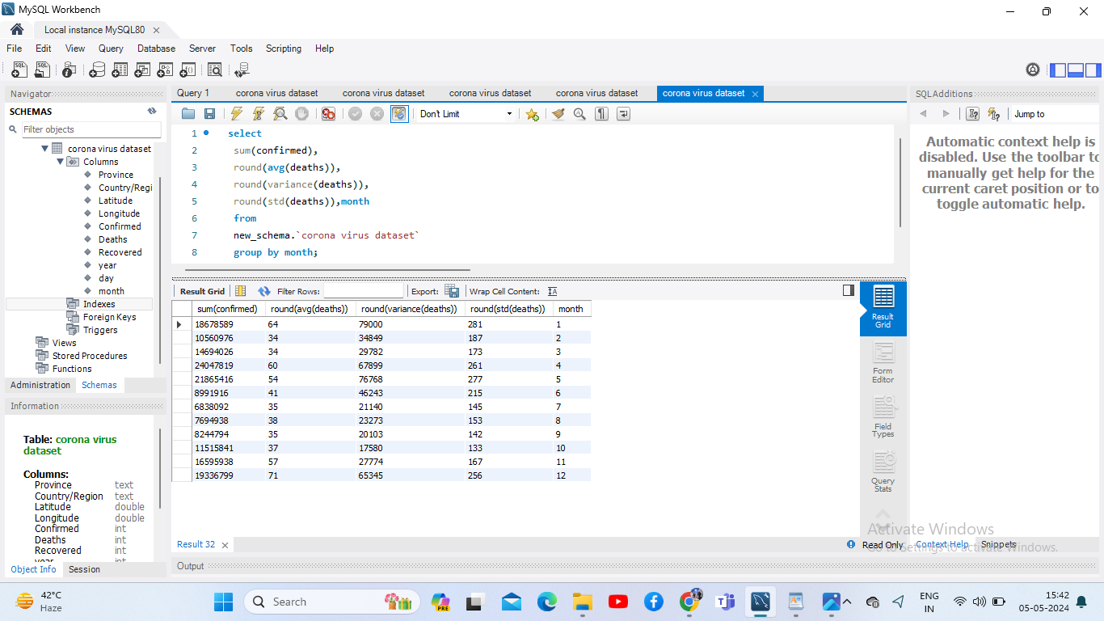
how corona virus spread out with respect to death case per month

Slide 18
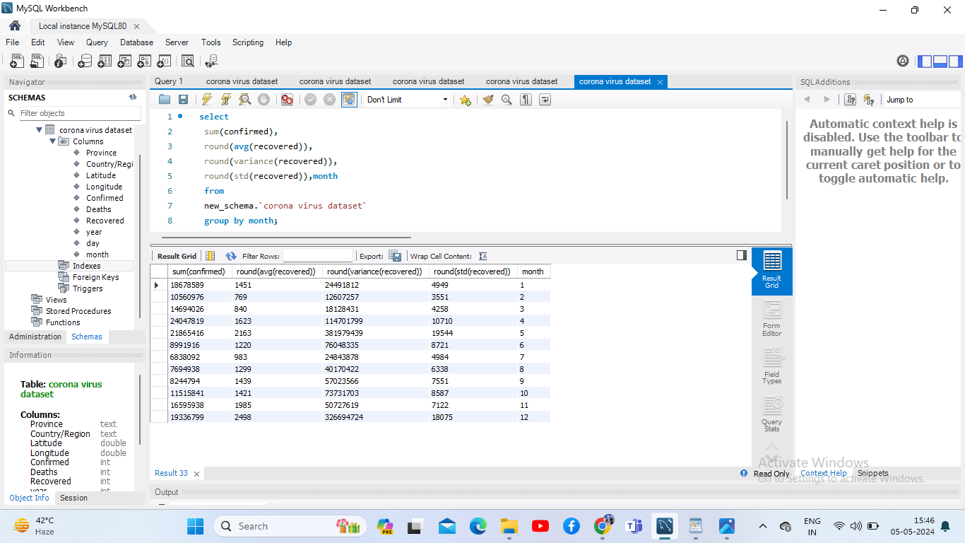
how corona virus spread out with respect to recovered case

Slide 19
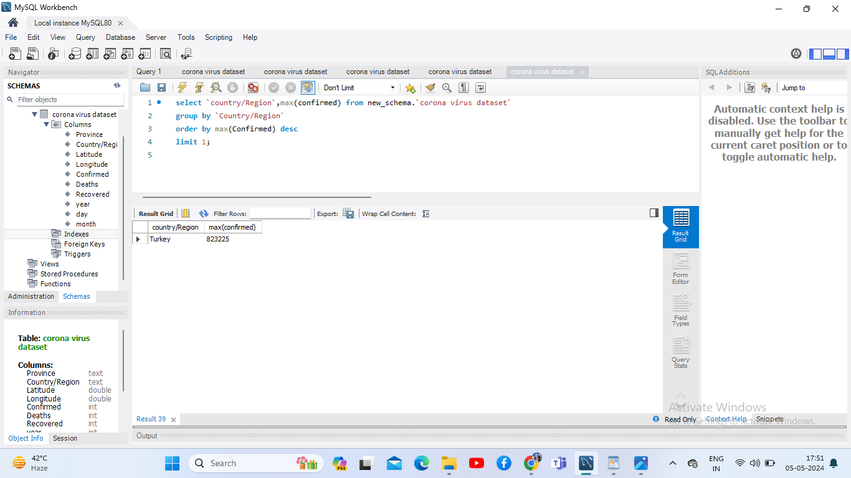
Country having highest number of confirmed cases

Slide 20
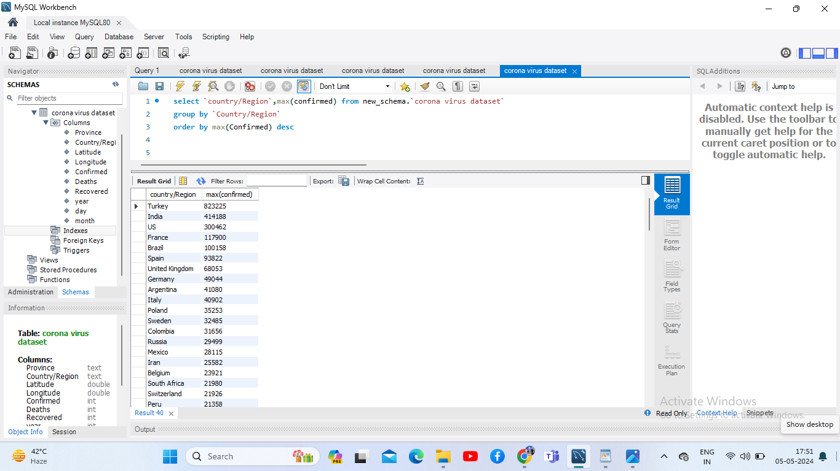
Countries having highest number of confirmed cases

Slide 21

Country having lowest number of death cases

Slide 22
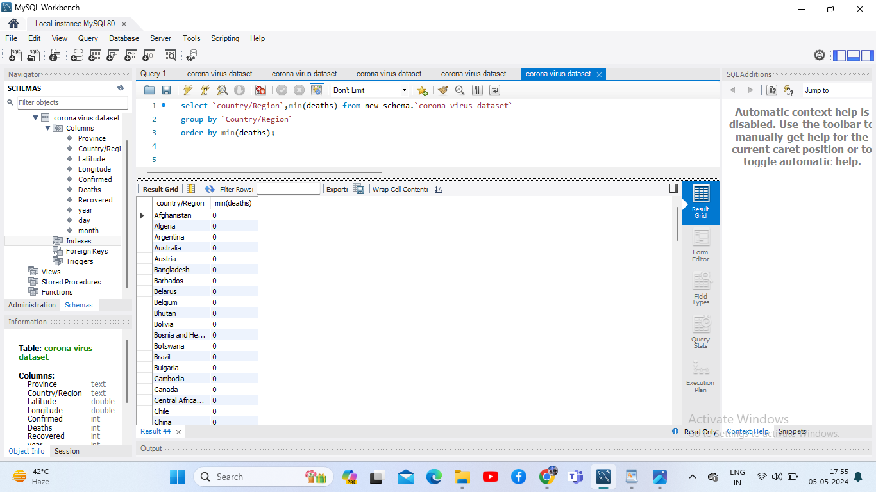
Countries having lowest number of death cases

Slide 23
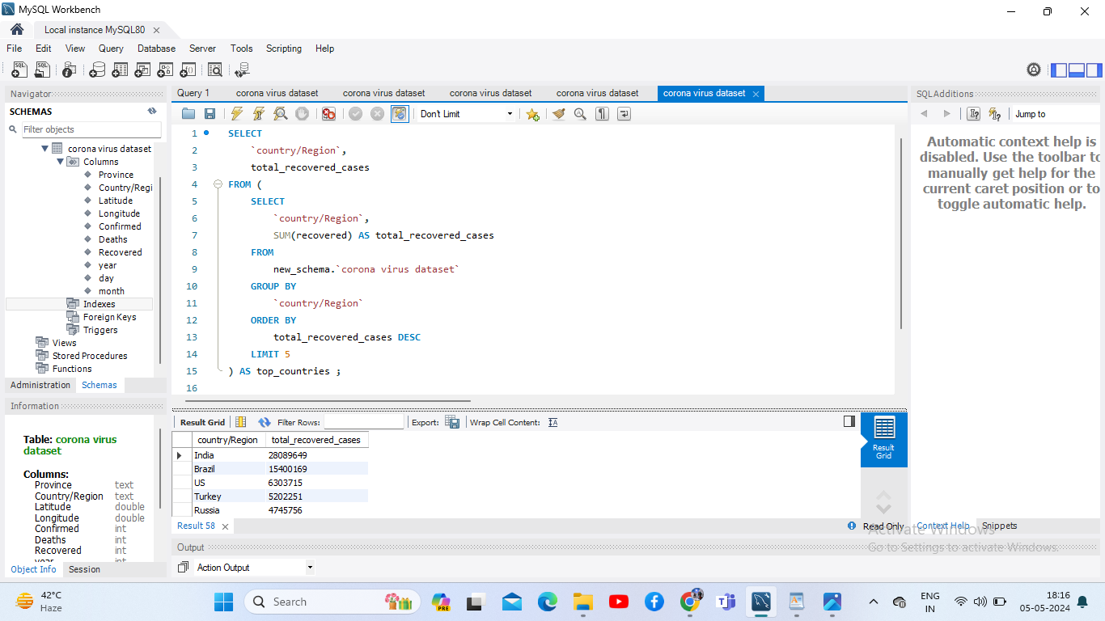
Top 5 countries having highest recovered case

